Slide 1
Project Sword a MedPAC Rebuttal
Analyzing cost report data to reveal the true financial status and trends of home health agencies
By Kalon Mitchell

Slide 2
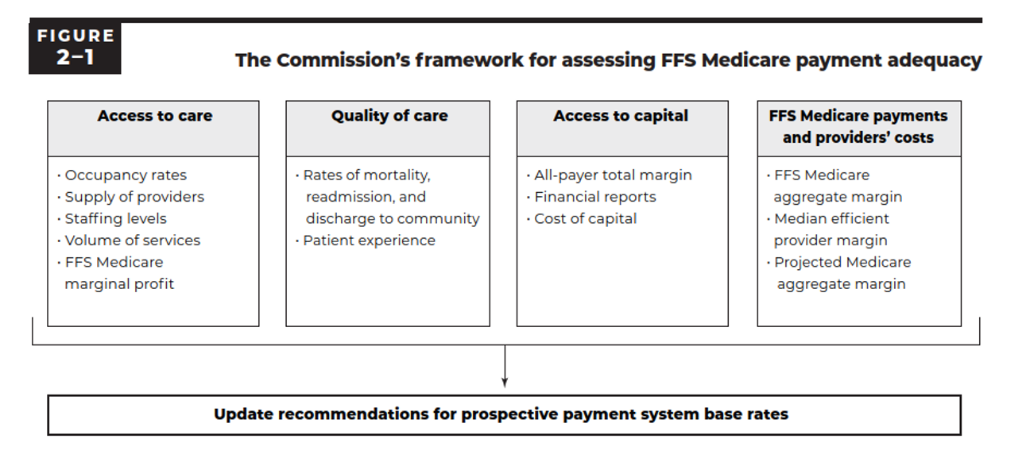
MedPAC’s Criteria for Recommending Base Rate Changes (March 2024 Report)

Slide 3
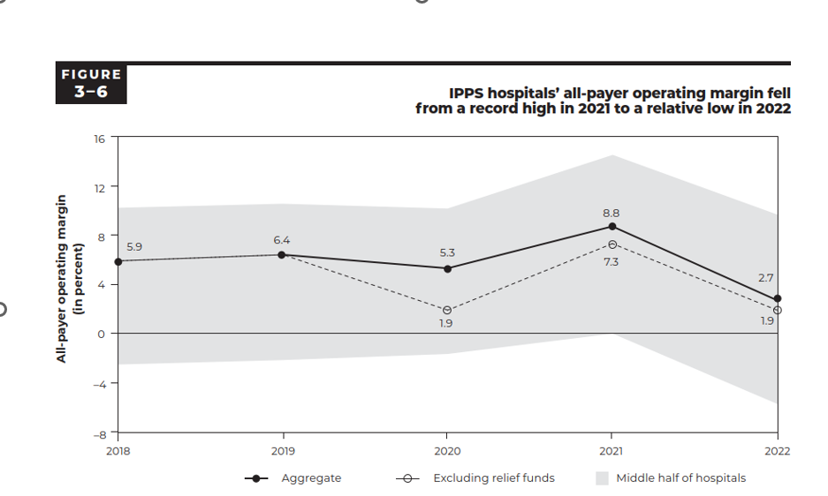
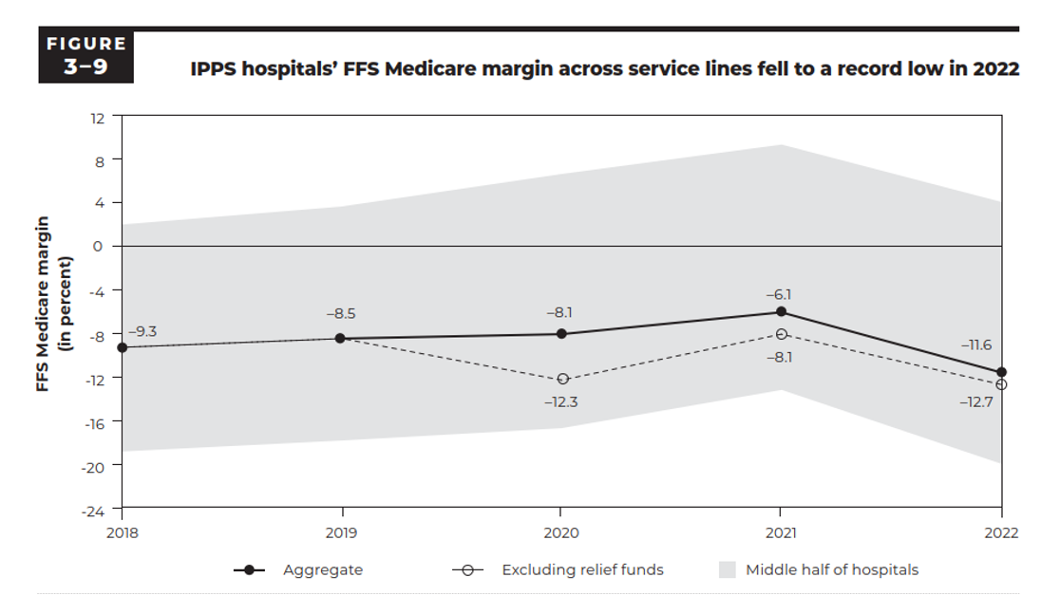
MedPAC’s Analysis of Hospital Profits All-Payer and Medicare Only

Slide 4
MedPAC's Analysis of HHA Profits
MedPAC provides no charts or data for All-Payer margins for HHAs
Why?

Slide 5
MedPAC vs Sword Margin Calculation

Slide 6
MedPAC Recommends Hospital base rates up 3% and HHAs Down 7% for 2025
Hospital Data from MedPAC – HHA Data from Sword
Source: Cost Report Data through 1st Quarter 2024

Slide 7
Home Health Census and Revenue by Financial Class – 2022

Slide 8
HHA Margins for Medicare and MA

Slide 9
Breaking Down Cost Reports by HHA Size Using Annual Census for 2022
Agency Size | % of All HHAs | % of All Census
Small (0 – 500) | 57.26 | 10.91
Medium (501 – 1500) | 25.64 | 22.54
Large (1501 – 5000) | 14.15 | 34.98
XL (5000+) | 2.95 | 31.57

Slide 10
HHAs Reporting Losses Are Increasing

Slide 11
Medicare Part A as a Percentage of all Medicare (MA + Part A) by Agency Size

Slide 12
Medicare Margins and Visits by HHA Size

Slide 13
All Payer Margins and Visits by HHA Size

Slide 14
WellSky Data Shows Increasing HHA Referral Rejections

Slide 15
Conclusions and Questions
The home health industry is contracting at an increasing rate.
Small agencies (57% of all agencies) are disproportionately affected.
Small agencies can’t cut visits due to scale of workforce.
All agencies pay the same Behavioral Adjustment (BA) permanent adjustment “tax” regardless of their individual behavior.
Capital investment and acquisitions are stalled due to poor overall margins and the threat of additional cuts.
Hospitals have better overall margins than HHAs, yet…
Hospitals have a recommended increase of 3% by MedPAC.
HHAs have a recommended decrease of 7%.
MedPAC and CMS portray HHAs as overly profitable using just Medicare margins, overall margins show an industry in crisis.
Why is this missing HHA all payer data not provided by MedPAC?
What is the future for HHAs and all healthcare with these home health BA cuts continuing?
What is happening now, after 2022?

